Slide 1

HR DATA ANALYSIS
PRESENTATED BY:
Saloni Malpani
Notes:
Links:
https://www.pexels.com/photo/photo-of-two-people-shakehands-2058130/

Slide 2
AGENDA
Project Overview
Analysis of all Questions
Conclusion

Slide 3

PROJECT OVERVIEW
Introduction:
- This project aims to perform a comprehensive analysis of HR data for a company, leveraging multiple datasets to gain insights into employee demographics, performance, satisfaction, and attrition.
Objectives:
- Identify factors influencing employee satisfaction, retention, and attrition rates.
- Analyze the relationships between employee attributes (age, income, job role, etc.) and job satisfaction or performance metrics.
Notes:
Links:
https://www.pexels.com/photo/man-in-black-suit-jacket-standing-near-railings-3778876/

Slide 4
- Uncover trends and patterns in the data that can inform HR strategies and decision-making.
Provide data-driven recommendations to improve employee retention, recruitment, and overall HR practices.
Datasets Used:
1. Employee Survey Data
- Contains employee responses to surveys regarding job satisfaction, work-life balance, and other factors.
2. General Data
- Includes employee demographic information, job details, salaries, and performance metrics.
3. In-time Data
- Records employee check-in times and attendance information.
Notes:
Links:
https://www.pexels.com/photo/man-in-black-suit-jacket-standing-near-railings-3778876/

Slide 5
4. Manager Survey Data
- Captures feedback from managers on their team's performance and dynamics.
5. Out-time Data
- Records employee check-out times and attendance information.
These datasets will be integrated and analyzed using Excel and Power BI to uncover valuable insights and answer specific questions related to HR practices and employee management.
Notes:
Links:
https://www.pexels.com/photo/man-in-black-suit-jacket-standing-near-railings-3778876/

Slide 6
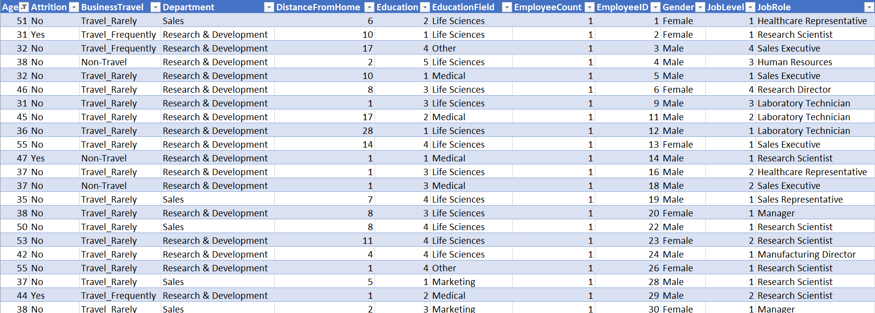
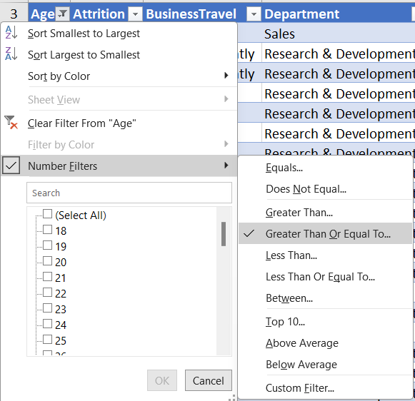
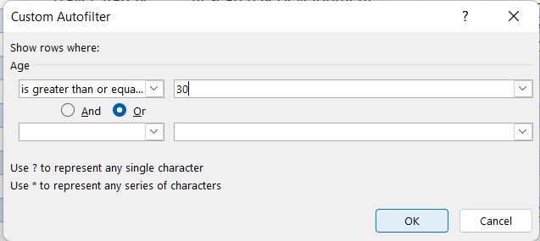



DATA ANALYSIS
1. Using Excel, how would you filter the dataset to only show employees aged 30 and above?

Slide 7

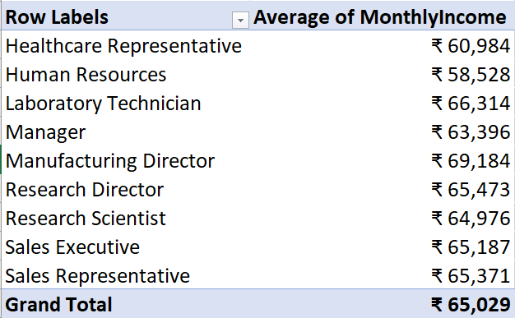


2. Create a pivot table to summarize the average Monthly Income by Job Role.
Interpretation:
The pivot table shows the Job Roles with the highest and lowest average Monthly Income, Manufacturing Director and Human Resource respectively.
A general trend of higher income for more senior or specialized roles is observed.
Role Human Resource appears as an outlier with relatively low average income compared to similar roles.
Notes:
Links:
https://www.pexels.com/photo/architectural-design-architecture-buildings-city-373893/
https://www.pexels.com/photo/high-rise-building-746411/
https://www.pexels.com/photo/architecture-buildings-business-city-358502/

Slide 8
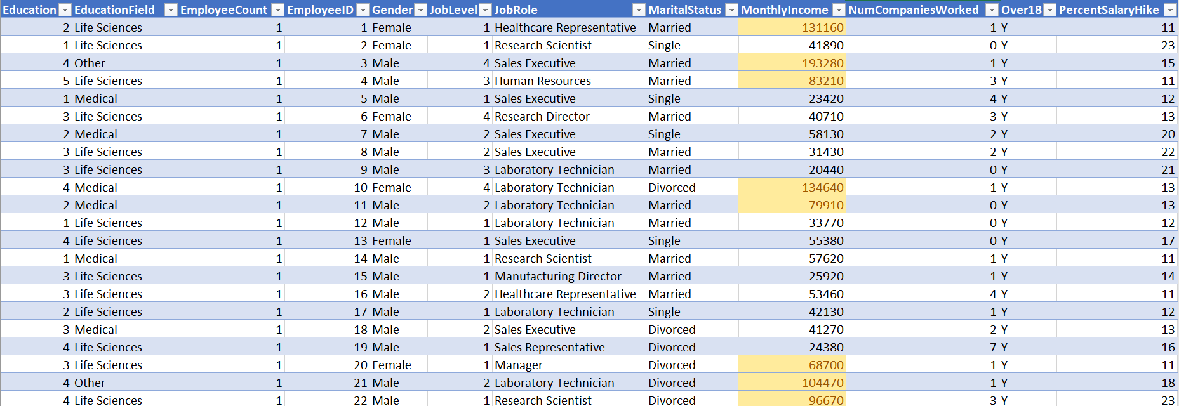
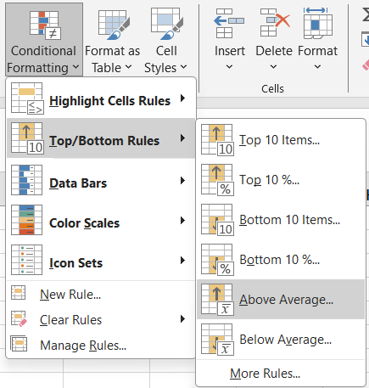
3. Apply conditional formatting to highlight employees with Monthly Income above the company's average income.

Slide 9
4. Create a bar chart in Excel to visualize the distribution of employee ages.
Interpretation
The bar chart reveals a concentration of employees in the 25-40 age group category, potentially indicating a need for initiatives to attract and retain more experienced talent.
There is a noticeable gap or underrepresentation in the 50-60 age segment, which may suggest a requirement for succession planning and knowledge transfer programs.

Slide 10
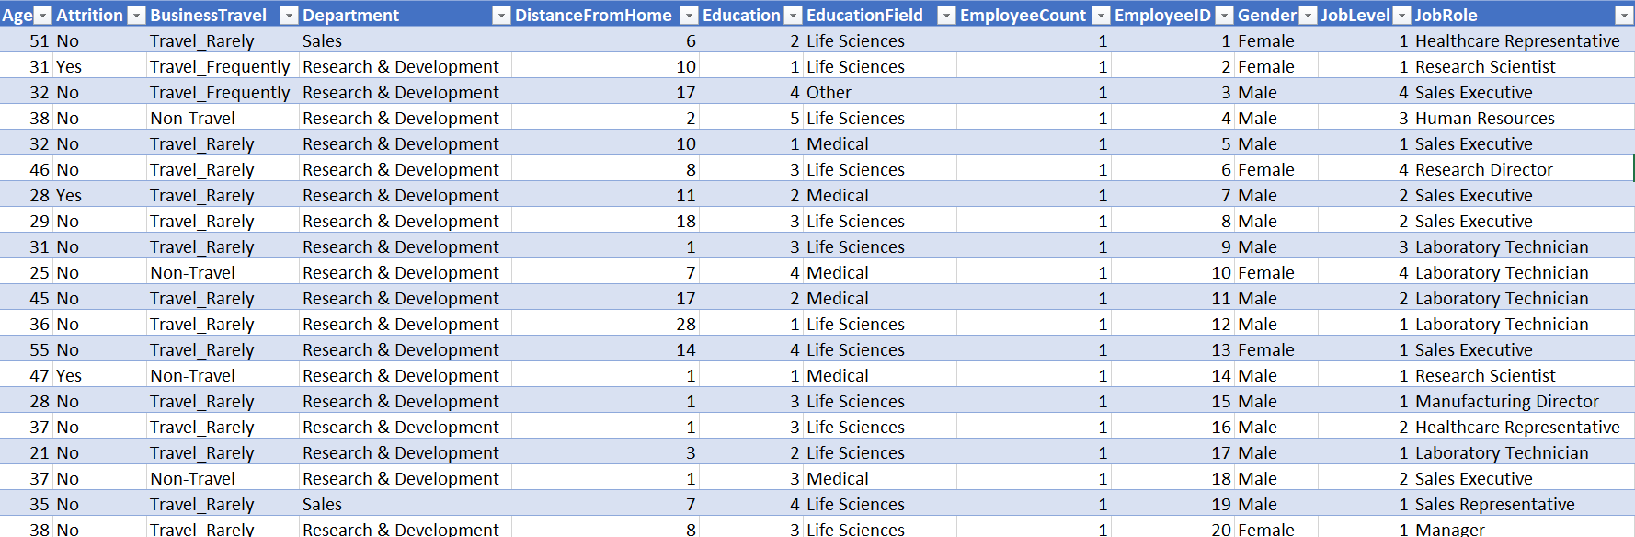
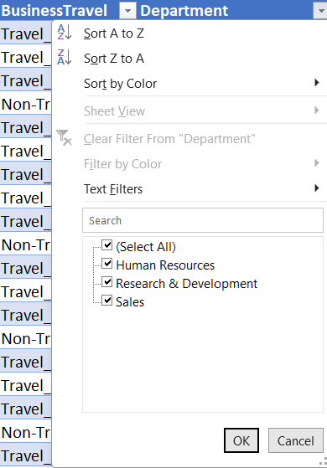
5. Identify and clean any missing or inconsistent data in the "Department" column.
Interpretation:
After thoroughly examining the data, the "Department" column was found to be complete and consistent, with no missing or inconsistent values.
This ensures that the analysis and insights related to employee departments will be based on accurate and reliable data.

Slide 11

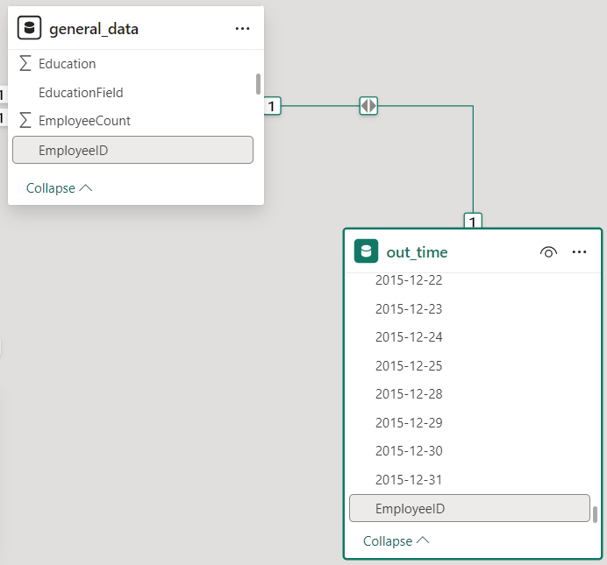
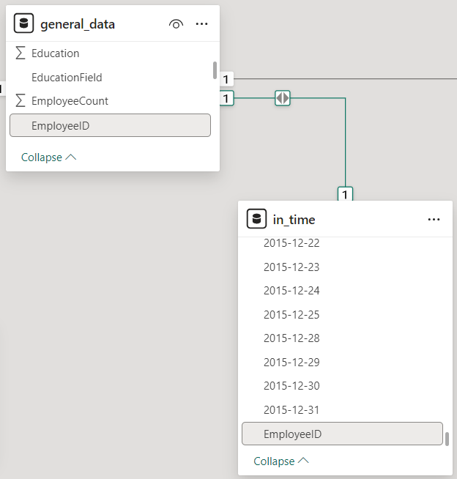
6. In Power BI, establish a relationship between the "EmployeeID" in the employee data and the "EmployeeID" in the time tracking data.
Notes:
Links:
https://www.pexels.com/photo/group-of-people-standing-infront-of-blackboard-3184432/

Slide 12


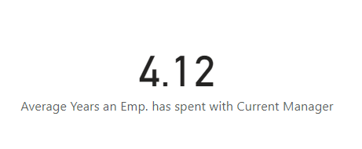
7. Using DAX, create a calculated column that calculates the average years an employee has spent with their current manager.
Interpretation:
A calculated column was created using DAX to determine the average years an employee has spent with their current manager.
This metric provides insights into the tenure and stability of manager-employee relationships.
Longer tenures may indicate stronger relationships, better knowledge transfer, and continuity in leadership.
Shorter tenures could suggest higher manager turnover, disrupting team dynamics.
This metric can be analyzed alongside other employee attributes to identify patterns and focus areas for improving manager-employee relationships.
FORMULA
Average Years an Emp. has spent with Current Manager = AVERAGE(general_data[YearsWithCurrManager])
Notes:
Links:
https://www.pexels.com/photo/person-holding-barbell-841130/
https://www.pexels.com/photo/human-fist-163431/

Slide 13
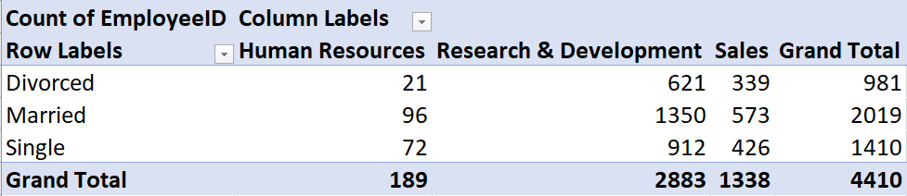
8. Using Excel, create a pivot table that displays the count of employees in each Marital Status category, segmented by Department.
Interpretation:
The pivot table shows the employee count by Marital Status within each Department.
Departments with highest/lowest counts for each Marital Status category are highlighted i.e , Research & Development has highest 'Married' count and Human Resource has lowest 'Married' count.
Noticeable patterns or deviations in Marital Status distribution across Departments are identified i.e., higher 'Divorced' concentration in Rresearch and Development.
This analysis informs tailoring of employee benefits, policies, and support programs based on Marital Status composition within Departments.
Limitations include the need for additional context and factors influencing Marital Status distribution.

Slide 14
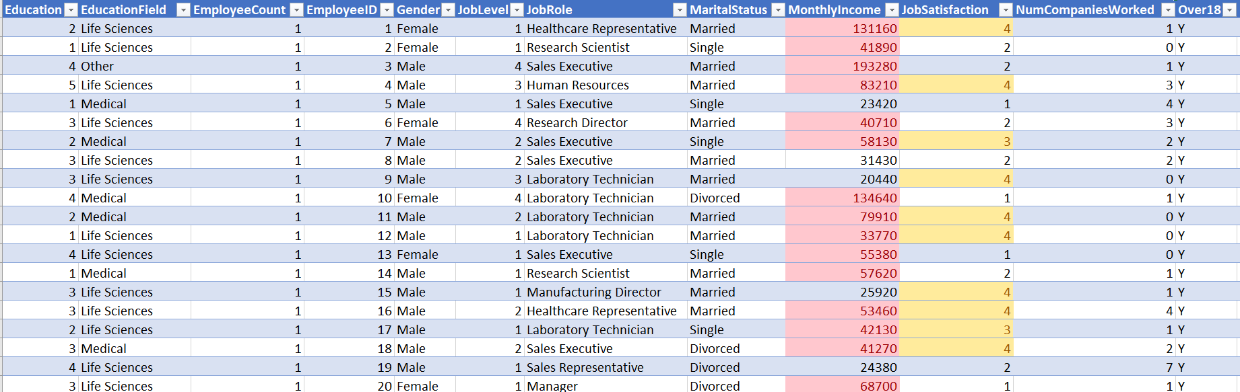
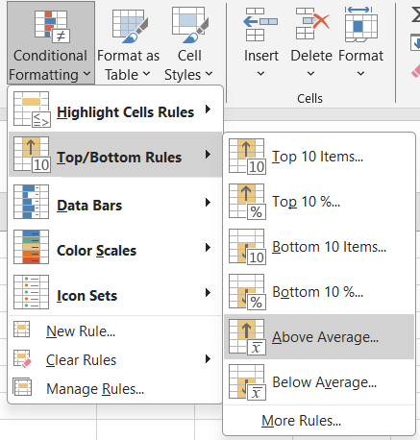
9. Apply conditional formatting to highlight employees with both above-average Monthly Income and above-average Job Satisfaction.
Above-average Monthly Income are in red colour and above-average Job Satisfaction are in yellow colour.

Slide 15
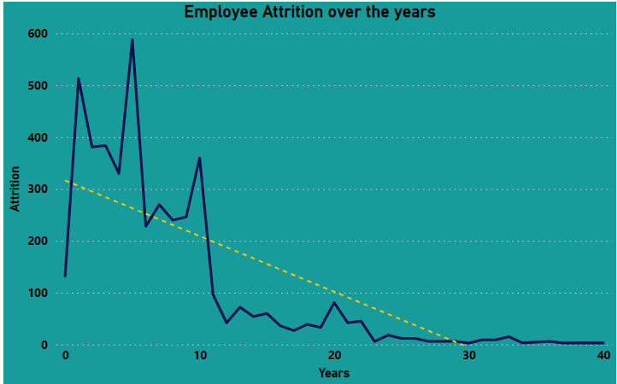
10. In Power BI, create a line chart that visualizes the trend of Employee Attrition over the years.
Interpretation
The line chart displays the year-over-year trend in Employee Attrition rates.
The chart shows an upward trend in Employee Attrition from 1 year to 10 year, followed by a decline in recent years.

Slide 16
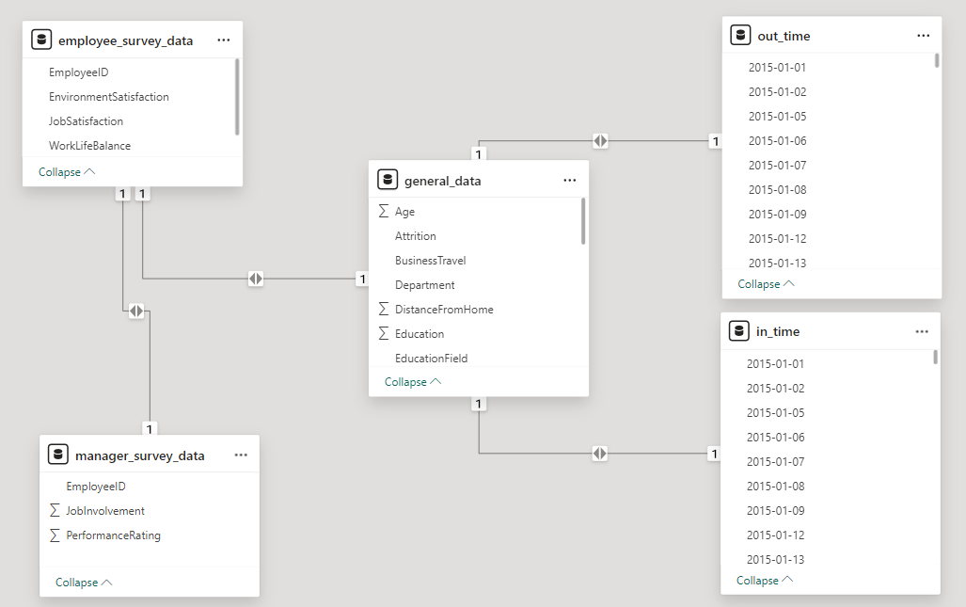

11. Describe how you would create a star schema for this dataset, explaining the benefits of doing so.
Notes:
Links:
https://www.pexels.com/photo/photo-of-people-doing-handshakes-3183197/
https://www.pexels.com/photo/photo-of-two-people-shakehands-2058130/

Slide 17
Fact Table:
1.General Data Fact Table: This table will contain the primary measures related to HR data analysis. It could include columns such as:
Age
Attrition
BusinessTravel
Department
DistanceFromHome
Education
EducationField
EmployeeCount
EmployeeID
Gender
JobLevel
JobRole
MaritalStatus
MonthlyIncome
NumCompaniesWorked
Over18
PercentSalaryHike
StandardHours
StockOptionLevel

Slide 18
TotalWorkingYears
TrainingTimesLastYear
YearsAtCompany
YearsSinceLastPromotion
YearsWithCurrManager
TerminationType
TerminationDescription
2.Dimension Tables:
1.Employee Survey Dimension: It Could include columns like:
EmployeeID
EnvironmentSatisfaction
JobSatisfaction
WorkLifeBalance
2.Manager Survey Dimension: It could include column such as :
EmployeeID
JobInvolvement
PerformanceRating

Slide 19
3.Time Dimension: This table holds information related to Time.
Benefits of Star Schema:
1.Simplicity: A star schema is simple and easy to understand, making it easier for analysts and stakeholders to navigate and query the data.
2.Query Performance: Star schemas optimize query performance by reducing the number of joins required to retrieve data, which is crucial for analyzing large HR datasets efficiently.
3.Scalability: Star schemas are scalable and can handle growing volumes of HR data without sacrificing performance, making them suitable for organizations of all sizes.
4.Ease of Analysis: The star schema structure facilitates easy analysis of HR metrics by providing a clear relationship between dimensions and the central fact table, allowing analysts to explore trends and patterns in the data effectively.
5.Flexibility: Star schemas can accommodate changes in reporting requirements or business needs by easily adding or modifying dimensions or measures, ensuring the schema remains adaptable to evolving HR analytics needs.

Slide 20
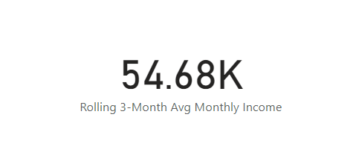
12. Using DAX, calculate the rolling 3-month average of Monthly Income for each employee.
Interpretation:
FORMULA
This metric provides a smoothed view of income trends by averaging the current month's income with the previous two months.
The overall 3-month rolling average for Monthly Income across all employees is $54.68K.
This analysis helps identify short-term fluctuations or patterns in employee income over time.
Rolling 3-Month Avg Monthly Income =
VAR CurrentID = MAX(general_data[EmployeeID])
VAR RollingWindow = FILTER(
ALL(general_data),
general_data[EmployeeID] = CurrentID &&
general_data[EmployeeID] <= MAX(general_data[EmployeeID]) &&
general_data[EmployeeID] >= MAX(general_data[EmployeeID]) - 2
)
RETURN
AVERAGEX(
RollingWindow,
general_data[MonthlyIncome]
)
Notes:
Links:
https://www.pexels.com/photo/person-holding-barbell-841130/
https://www.pexels.com/photo/human-fist-163431/

Slide 21

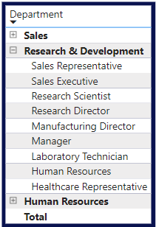

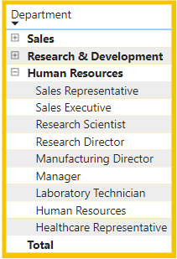


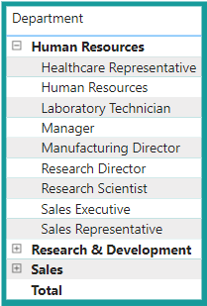

13. Create a hierarchy in Power BI that allows users to drill down from Department to Job Role to further narrow their analysis.
Notes:
Links:
https://www.pexels.com/photo/close-up-of-human-hand-327540/

Slide 22
14. How can you set up parameterized queries in Power BI to allow users to filter data based on the Distance from Home column?
To enable users to filter data based on the Distance from Home column using parameterized queries in Power BI, follow these steps:
1.Create a Parameter:
Open your Power BI Desktop file.
Navigate to the "Modeling" tab in the ribbon menu at the top.
Click on "New Parameter" in the "Modeling" section.
Name the parameter (e.g., "DistanceParameter") and set its data type to Decimal Number.
Specify the desired default value and any constraints if needed.
Click "OK" to create the parameter.
2.Modify the Query:
Access the query editor by clicking on "Transform Data."
Locate the query responsible for loading your data.
Add a new step to filter the data based on the Distance from Home column using the parameter created in step 1.
Use the following Power Query M language syntax:
= Table.SelectRows(#"PreviousStep", each [Distance from Home] <= DistanceParameter)

Slide 23
3.Apply Changes:
After adding the filtering step, click on "Close & Apply" to apply the changes.
This will load the modified data into your Power BI report.
4.Parameter Control:
Add a slicer visual to your report by selecting the slicer icon from the Visualization pane.
Bind the slicer to the "DistanceParameter" parameter created earlier.
Users can now dynamically adjust the slicer to filter data based on the Distance from Home column.

Slide 24
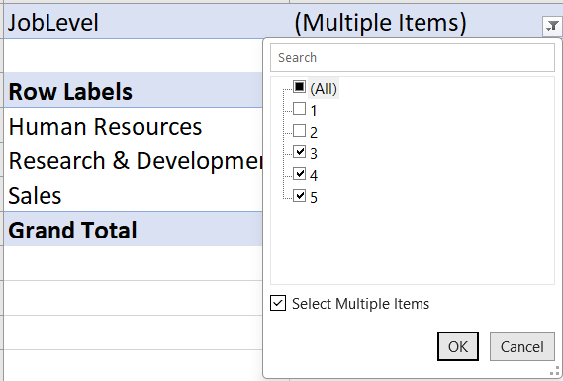
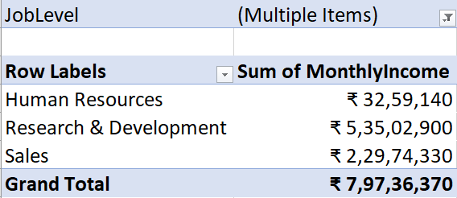
15. In Excel, calculate the total Monthly Income for each Department, considering only the employees with a Job Level greater than or equal to 3.
Notes:
Links:
https://www.pexels.com/photo/group-of-people-standing-infront-of-blackboard-3184432/

Slide 25
16. Explain how to perform a What-If analysis in Excel to understand the impact of a 10% increase in Percent Salary Hike on Monthly Income.
Performing a What-If Analysis in Excel
A What-If analysis in Excel allows us to understand the impact of changing variables on calculated outcomes. To assess the effect of a 10% increase in Percent Salary Hike on Monthly Income, we can utilize two primary methods: Data Tables and Goal Seek.
Data Tables:
Set up Your Data: Organize data with columns for Percent Salary Hike, Monthly Income, and a calculated column for the Monthly Income after the increase.
Create a Data Table: Select the range of original Monthly Income values, navigate to the "Data" tab, click "What-If Analysis," and choose "Data Table." Specify the Row Input Cell (Percent Salary Hike) to observe the results.
Goal Seek:
Set up Your Data: Organize data similarly, with columns for Percent Salary Hike and Monthly Income.

Slide 26
2. Perform Goal Seek: Select the cell containing the calculated Monthly Income after the increase, go to the "Data" tab, click "What-If Analysis," and select "Goal Seek." Set the cell to the desired target value by changing the Percent Salary Hike cell.
In conclusion, What-If analysis empowers us to make informed decisions by understanding how changes in input variables affect outcomes. By employing Data Tables and Goal Seek in Excel, we can analyze various scenarios and their impact on Monthly Income.

Slide 27
17. Verify if the data adheres to a predefined schema. What actions would you take if you find inconsistencies?
Verifying Data Adherence to Predefined Schema and Addressing Inconsistencies
Data Verification Process:
Compare Against Predefined Schema: Utilize the predefined schema, including specifications for data types, formats, ranges, and relationships, to assess the actual data.
Data Profiling: Employ data profiling techniques or automated tools to identify any discrepancies or inconsistencies.
Actions for Inconsistencies:
Documentation: Document the inconsistencies found, detailing affected data fields, the nature of inconsistencies, and potential downstream impacts.
Data Cleansing: Perform data cleansing procedures to correct minor or systematic inconsistencies, such as standardizing formats, removing duplicates, or filling in missing values.
Data Transformation: Restructure or reshape data to align with schema requirements if inconsistencies arise due to structural differences or missing fields.
Data Reconciliation: Conduct reconciliation to identify and resolve discrepancies between different data sources or versions.

Slide 28
5. Communication: Communicate findings and proposed actions to relevant stakeholders, including data owners, analysts, and decision-makers, and gather feedback on proposed solutions.
6. Iterative Improvement: Implement measures to prevent future inconsistencies, such as refining data entry processes, enhancing validation rules, or providing additional training.
Validation and Re-Verification:
Post-Correction Validation: Validate data after corrective actions to ensure effective resolution of inconsistencies and adherence to the schema.
Periodic Re-Verification: Establish a periodic process to monitor data quality and address new inconsistencies over time.

Slide 29
CONCLUSION
This comprehensive HR data analysis uncovered valuable insights into employee demographics, performance, satisfaction, and attrition.
Key findings include:
"The analysis revealed a correlation between job role seniority and average monthly income, with more specialized roles commanding higher salaries."
"Employee attrition rates showed an upward trend from 0 to 10 years.
These insights enable informed decision-making in areas like compensation, workforce planning, employee engagement, and training.
Leveraging Excel and Power BI facilitated effective data cleaning, modeling, and visualization.
The project demonstrates the value of data-driven approaches in HR management.
Recommendations:
Continue monitoring HR data regularly
Incorporate additional data sources
Refine analytical processes for deeper insights
The insights contribute to creating an engaged, productive, and satisfied workforce, driving organizational success.

Slide 30
THANK YOU
Notes:
This template is provided by https://www.free-power-point-templates.com/
Links:
https://www.pexels.com/photo/photo-of-two-people-shakehands-2058130/

